Slide 1
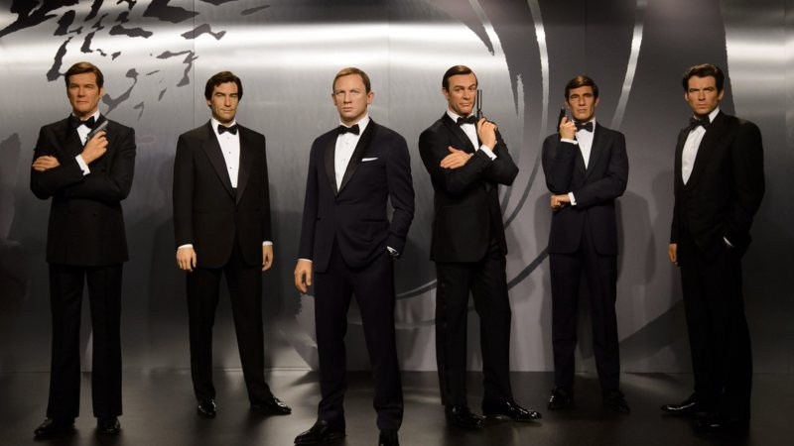
James bond and feminism?
- Isabella de Wit A5B

Slide 2
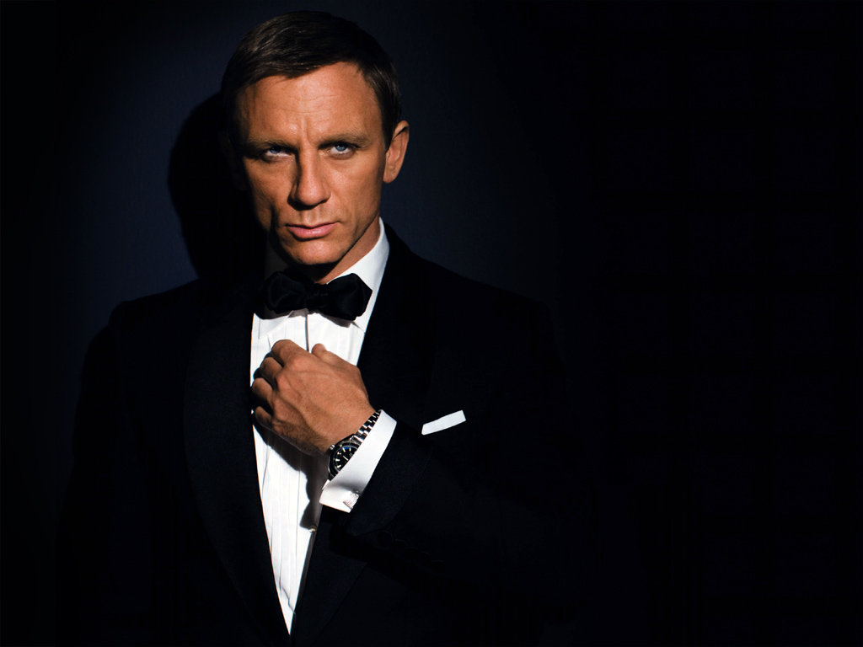
unattainable
Womanizer
Succesfull at requiering attractive women
Casual relationships, never gives himself away to anyone.
Who can decode James bond?

Slide 3
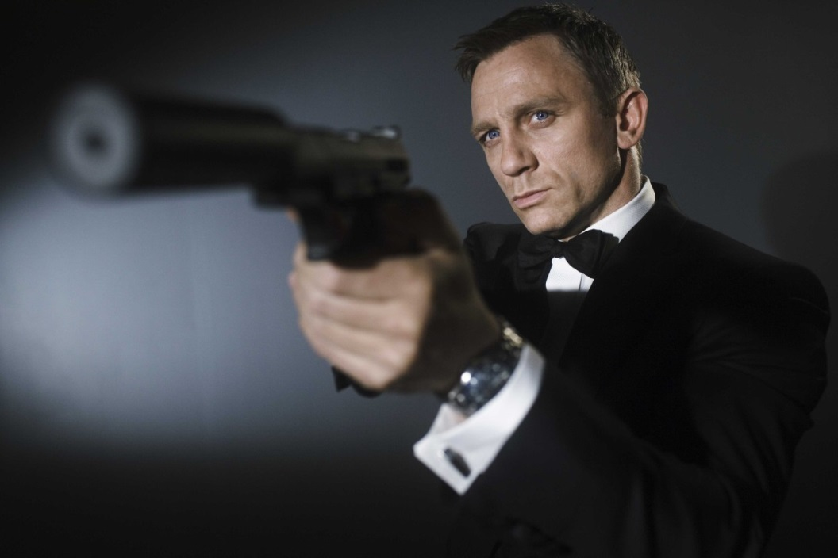
Good physique
man of action
Goes straight towards his goals
He is determined
Overwhelming confidence

Slide 4
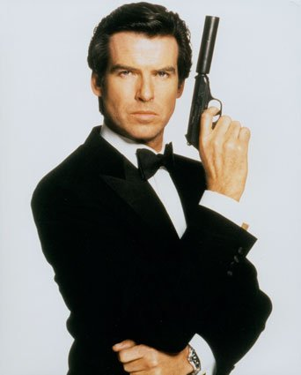
Very sensual
Knows what to say
Charming
Easily noticable, the way he
walks, moves and looks.
He also is a good dresser

Slide 5
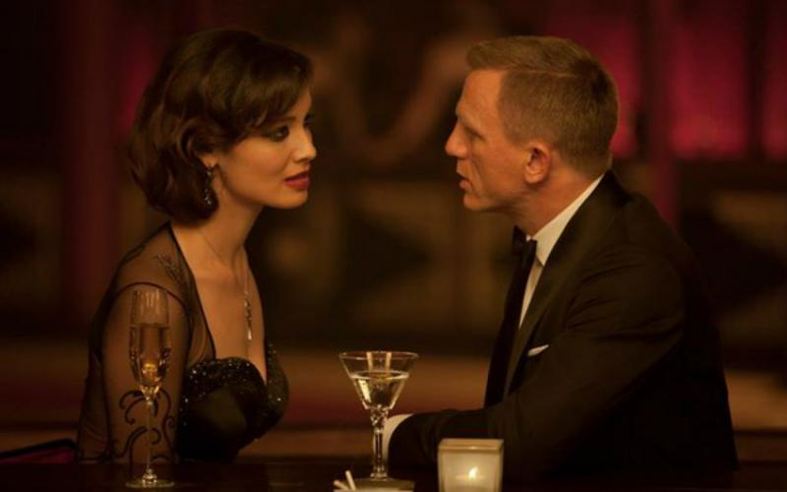

Slide 6
How are women portrayed?
A women’s place is in the bedroom?
Sexual partners ending up dead
Demeaning names: Honey Rider, Pussy Galore, Octopussy
Just pretty looking women
(Honey Rider as an example)

Slide 7
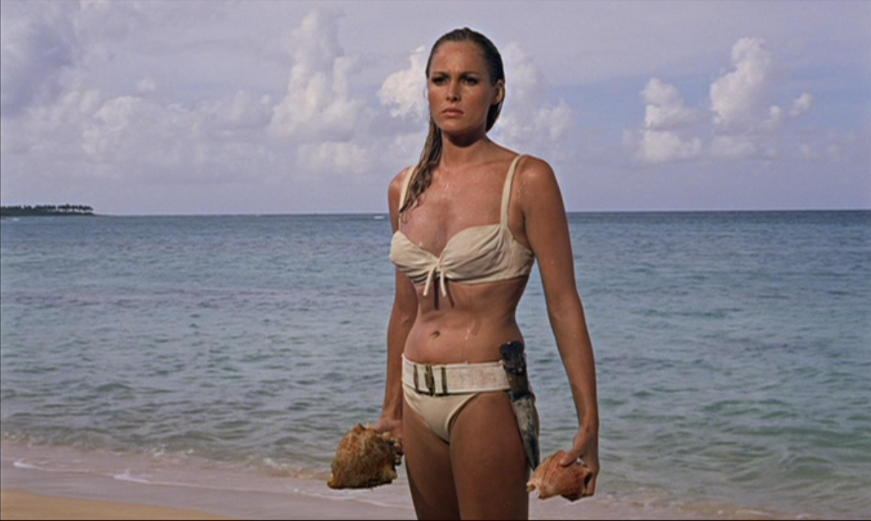
Honey rider
Just a goodlooking blondine
The sexy blonde exits the sea in a white bikini while she sings the song "Under the Mango Tree", Bond sings this song and they meet each other.
Ursula Andress
Dr. No (1962)

Slide 8
M is a woman
Played by ‘Dame Judi Dench’

Slide 9
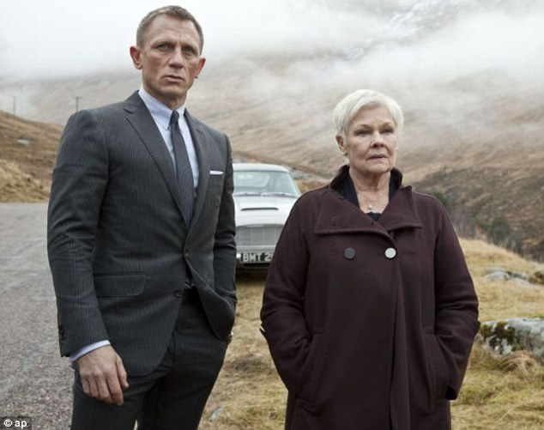
M is a woman
In 1995 Pierce Brosnan plays M. Women finally start to take over.
First time bond’s lady is a mentor and not a lover.

Slide 10
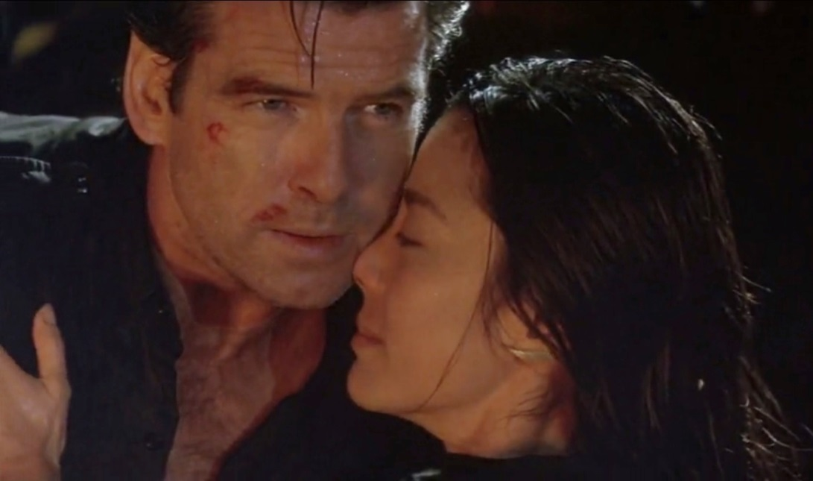
Wai lin “tomorrow never dies’
Wai Lin was a Red Chinese agent, and had the same mission as Bond to investigate media magnate Elliot Carver. Carver had been suspected of causing tragic events so that he could get exclusive coverage on them and increase his ratings. Wai Lin was intelligent and worked more cleverly than Bond on several occasions. Eventually they teamed up together and stormed Carver's stealth ship.

Slide 11
Other strong character
Elektra king
“the world is not enough”
Madeleinne Swann
“ Spectre”

Slide 12
Development
Even the secretary ‘Moneypenny’ got remodeled for her own good.
In spectre and skyfall she is a field agent
The choice to make Daniel Craig a bond, was a nod to independent women, he knows how to fight for equality
A long story short, over the years women got to play more important parts. They became more equal. They started to have strong opinions. They weren’t just “James bond his love interest’. their characters over 50 years became increasingly nuanced and complex. Not just pretty girls, wicked women and bedmates.
Watch link to see Daniel Craig standing up for the women
https://www.youtube.com/watch?v=gkp4t5NYzVM

