Slide 1
Panel 1
POLAND

Slide 2
Studying abroad
Motivate persons in your country to study abroad. Studies abroad in individual countries, at universities or on specific subjects (economics, law, art) can be highly valued both in Poland and by employers from abroad. Communicating in a multicultural environment has a great advantage, you gain friends from all over the world. The climate of another country, the environment, ecology, possibilities of living in a different environment are the pros of studying abroad.

Slide 3
Pluses of studying abroad
- Foreign universities enables its students to travel within the framework of programmes, e. g. Erasmus.
Knowledge and experience gained at foreign universities are appreciated by Polish employers.
Foreign practice or casual work, which is also useful when you return to Poland.
Independence, responsibility.

Slide 4
Poland- great place to study
The fact of Poland being in the middle of Europe makes a lot of sense when you realize that here you can feel the western concept of development, and the family and community belonging sense from east.

Slide 5
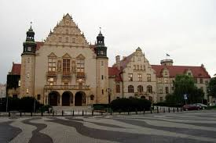
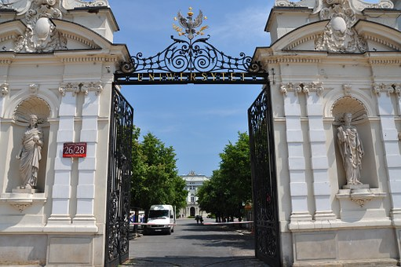
Why is it worth studying in Poland?
1.High Quality Universities
ones of the best Polish universities:
-The University of Warsaw
-The Jagiellonian University in Krakow
-The Adam Mickiewicz University in Poznań
-The Lodz Film School

Slide 6
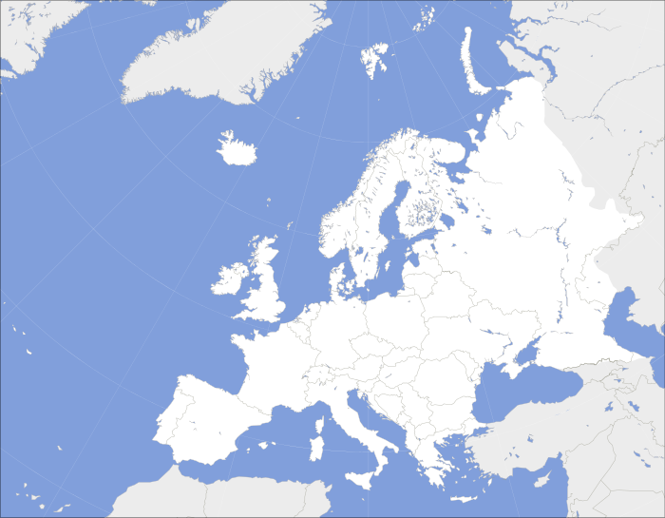
2. Costs
Studying in Poland is cheaper than doing so in other parts of Europe. Tuition fees start from less than 1500 EUR per year and rarely go higher than 3000 EUR.

Slide 7
Costs
- flat in the city centre or room ina student dormitory for 100-150 EUR.
- a monthly public transport tickets for 25 EUR per month or free bikes during the warmer half.
- a cinema ticket for 3 EUR.
- tasty lunch for 5 EUR.

Slide 8
3. Vibrant Student and Cultural Life
As we all know, being a student is much more than only studying. It is only as important as the other components of higher education: partying, sports, music festivals, film festivals, hanging out with friends, going out of town for the weekends, etc. This is why you’ll never regret choosing Poland. Thanks to our rapid economic growth in the last two decades, the cultural offerings of Poland are comparable to any other European country, but with its own character.

Slide 9
4. Poland is a part of the Erasmus Programme
5. Scholarships for Non-EU Students
If your country does not belong to the Erasmus network, there are still a handful of opportunities. Each year, a considerable number of scholarships for non-EU foreign students are launched.
The best way to find out is to contact the Polish embassy in your country, as they usually coordinate bilateral student exchange programmes.

Slide 10
What do you have to do to study in Poland?
documents confirming legal stay in Poland
medical certificate
insurance policy in the event of illness or accident for the period of education in Poland
good knowledge of languages ​​(language certificate)
the graduation document of the high school (secondary school-leaving certificates)

Slide 11
Popular majors of study
1.Medicine
Studying medicine overseas can provide Students with an invaluable experience and a quality education.

Slide 12
2.Law
A law degree is the first step on a number of work paths – including a career as a solicitor, barrister or judge. Many universities around the world provide law degrees, so it can be difficult to know which is the best one for you

Slide 13
3. Computer Science Studying computer science is a smart bet in today’s world, as the career opportunities for tech-savvy graduates are expanding every year.

Slide 14
Thanks for watching
Authors: Amelia Marcol Magdalena Kuśka Weronika Niemczyk Wiktoria Zmarzły

